Slide 1
Best practice results from Erasmus+ A European conference on Dissemination and Impact in the School Sector Bonn, May 17-19, 2017 Promoting citizenship and common values
KA1 School Staff Mobility project
“Per dei nuovi cittadini europei”
For new European citizens
n.2014_1_IT02_KA101_000949
Contact teacher Caterina Mazzuca

Slide 2
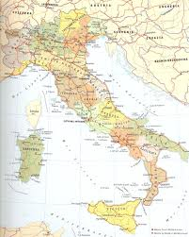
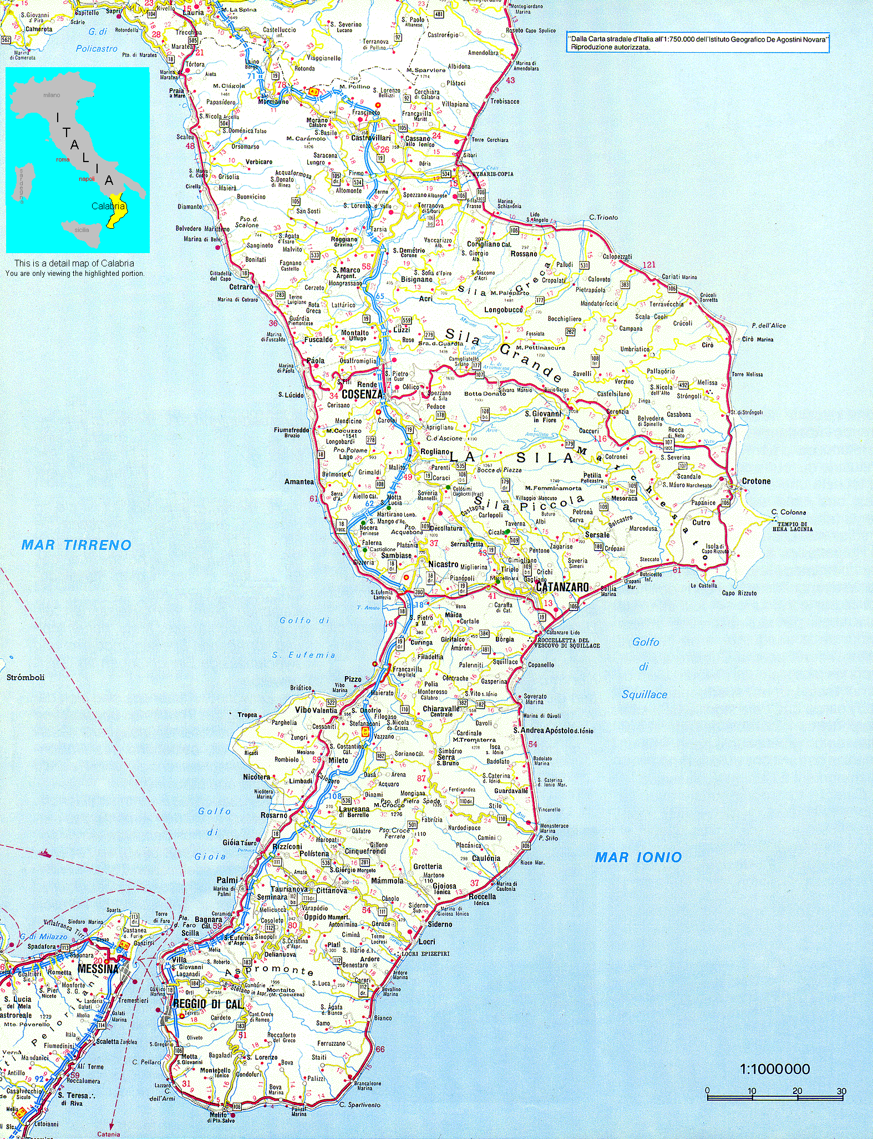
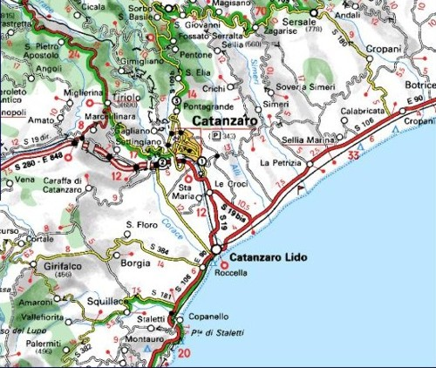
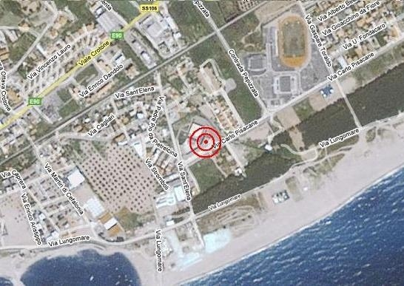

Slide 3
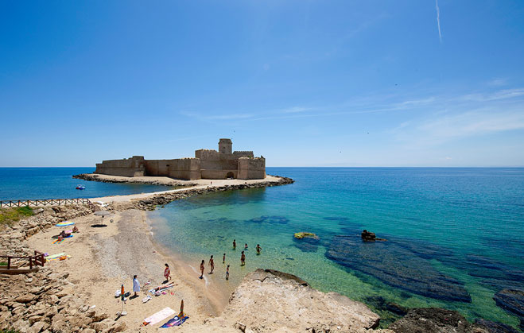
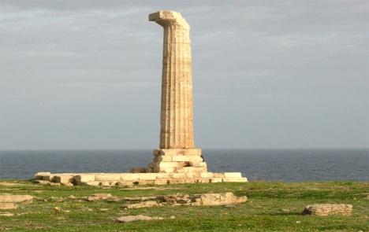
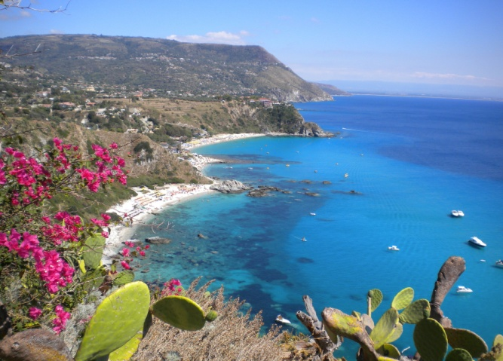
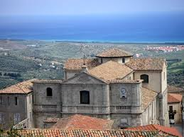
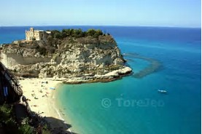
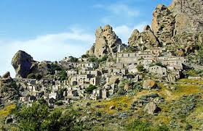
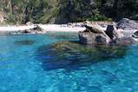
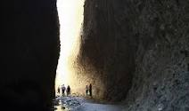
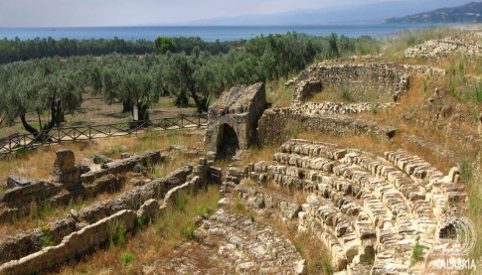
Archeological park
of Capo Colonna
Le Castella, Ionian sea
Squillace
Tropea, Tyrrhenian sea
Valli Cupe
Roccelletta di Borgia
Pentadattilo

Slide 4
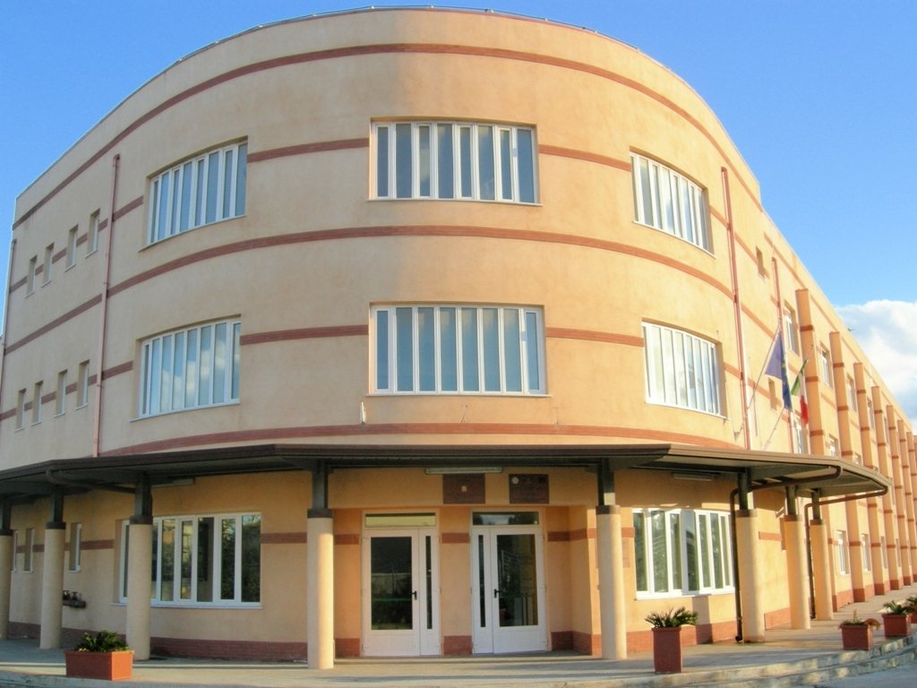
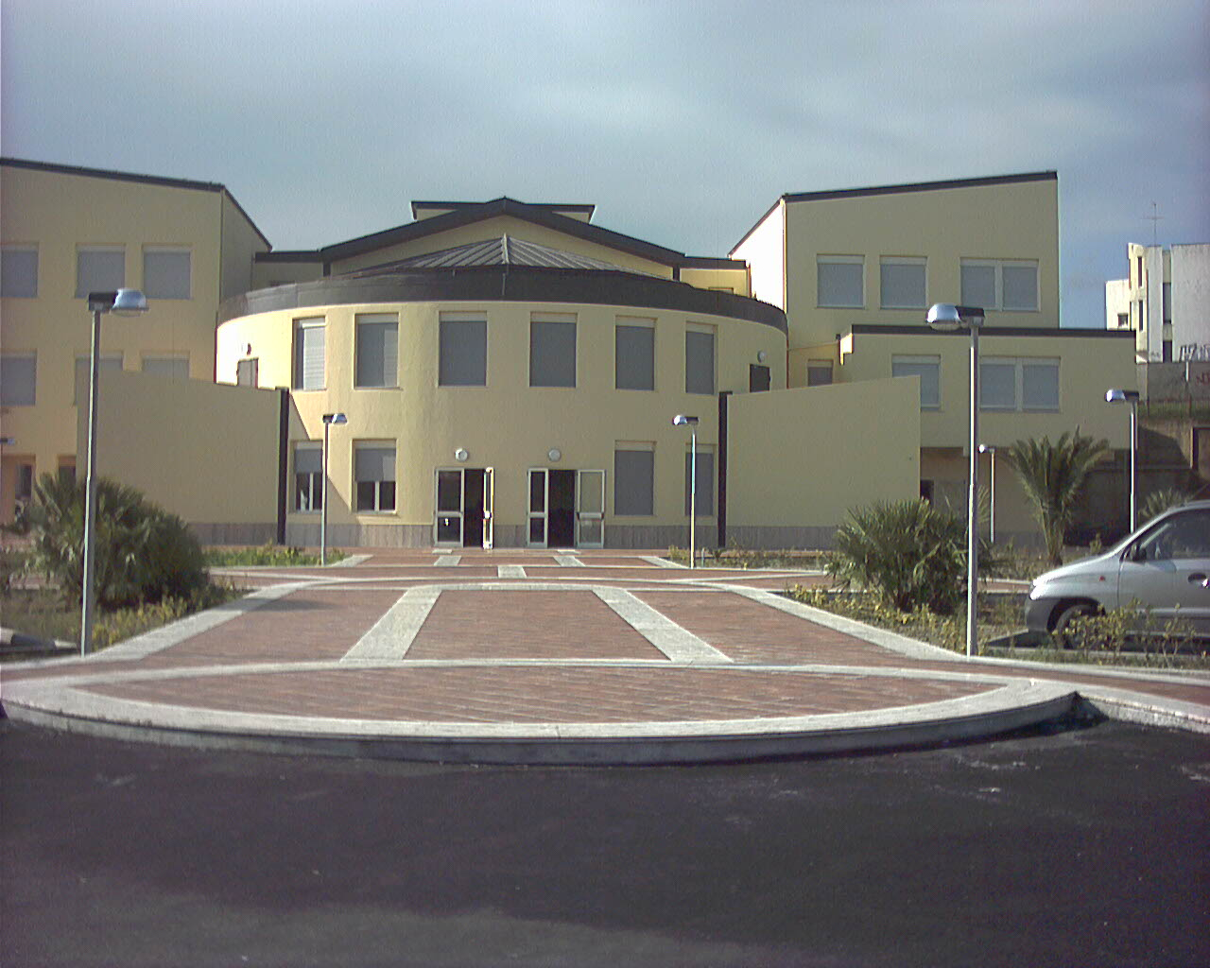
ISTITUTO DI ISTRUZIONE SUPERIORE "E. FERMI"
LICEO SCIENTIFICO
LICEO SPORTIVO
Science and Sport curricula
LICEO SCIENTIFICO
Science Curriculum
Sport Curriculum
LICEO LINGUISTICO
LICEO DELLE SCIENZE UMANE
Foreign Languages and Human Science curricula

Slide 5
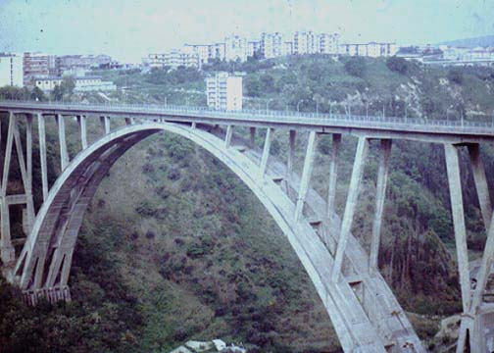
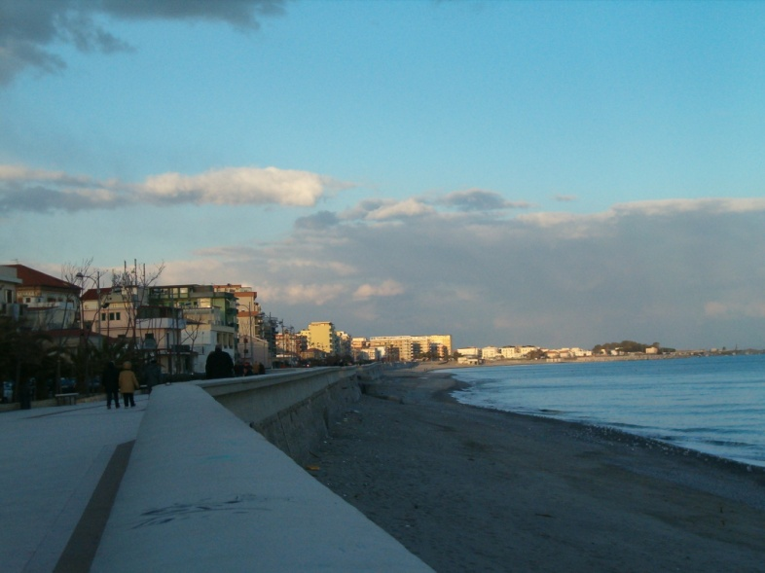
CITY OF CATANZARO
CATANZARO LIDO
The promenade
CATANZARO
The bridge “MORANDI”
ISTITUTO DI ISTRUZIONE SUPERIORE “E. FERMI”

Slide 6
ISTITUTO DI ISTRUZIONE SUPERIORE ENRICO FERMI, Catanzaro, ITALY
State General High School
1214 pupils, 109 teachers
Four main curricula:
Science
Sport
Human Science (with a Socio-economical option)
Foreign languages (with ESABAC option)

Slide 7
School Staff Mobility Project
Per dei nuovi cittadini europei
For new European citizens
A two-year project (2014-2016)
43 mobilities realized
13 Job shadowing
30 training courses
in
12 European countries (England, Finland, Estonia, Lithuania, Sweden, France, Portugal, Spain, Slovenia, Ireland, Latvia; Germany)
Participants
Headmaster and 27 teachers

Slide 8
General educational aim:
to educate our pupils to be
European citizens sharing Paris Declaration 2015 values such as freedom, tolerance, non-discrimination, equality, human rights and dignity
But in order to make young people accomplish social, civic and intercultural competences we need open-minded and well- trained teachers

Slide 9
ORIGINS OF THE PROJECT
“Per dei nuovi cittadini europei”
For new European citizens
Analysis of CAF (now RAV):
-teachers’ weaknesses
-main points for improvement
-pupils’ educational needs
-general school educational aim

Slide 10
Obstacles to face:
External obstacles
Internal obstacles

Slide 11
External obstacles:
Geographical (we live in a peripheral region. Europe is perceived as an abstract Wonderland) Just to make an example , to get to France or to Austria we need more than 2 hours with a direct flight, but by train it would take more than 14 hours)
Economical (Calabria is one of the poorest regions in Europe, a lot of families are coping with low living standards due to the current economic crisis)
Cultural backwardness due to the lack of knowledge of other cultures and unwillingness to exchanges.

Slide 12
Internal obstacles:
from teachers:
-High average age (most teachers are between 50 and 62)
-Self-centredness (most teachers are not particularly inclined to peer exchanges)
-Demotivation of teachers and reluctance to participate in Lifelong learning training activities
-Lack of organized team work
-Widespread unsatisfaction in daily work
-Poor knowledge of foreign languages and cultures that leads to narrow-mindedness
-Use of traditional teaching approaches and low ITC skills
-Gap between academic programs and real life.

Slide 13
Internal obstacles:
from learners:
-Weak basic competence levels as proved by the low results in INVALSI tests ,Yearly national tests, which were lower than the National average
-Low scores in university entry tests, particularly in the scientific fields
-Low wellness levels at school
-Little empathy with teachers
-Little interest in learning
-Very little knowledge of Europe and lack of awareness of being European citizens
-Poor knowledge of foreign languages, compared to European peers
-Low digital skills (confined to their spare time alone)

Slide 14
WEAKNESS | ACTION | RESULT
Self-centredness Unwillingness to exchanges Poor knowledge of European cultures and values | Job shadowing Benchmarking Creativity training courses Training courses on new methodologies through the use of ITC | Team working Sharing of good practices (use of digital learning platforms ,e.g. Edmodo,as a repository; eTwinning for training and learning) Overcoming of physical and mind borders through virtual and real twinning projects Open-mindedness Erasmus+ KA2 strategic partnerships
Poor knowledge of foreign languages Impossibility to activate CLIL modules | Language courses Job shadowing CLIL methodology courses for subject teachers | Achievement of certified levels B1 and B2 in English ( CEFR) Activation of CLIL modules
Demotivation of teachers and learners | learning of new teaching methodologies through the use of ITC learning new strategies to prevent dropping out | New learning environments thanks to new teaching/learning approaches ( cooperative learning, project-based learning , task-based learning, flipped classroom)
Teaching centred on contents and subject goals | job shadowing Training courses on new methodologies through the use of ITC | Open-mindedness Curricula aiming at developing 21st century life skills
Gap between academic programs and real life | Job shadowing Benchmarking Entrepreneurship and Creativity training course Training courses | Positive attitude to Lifelong learning Practice of new teaching approaches Work – related learning programmes

Slide 15
DISSEMINATION: AT 3 LEVELS
INTERNAL | LOCAL | NATIONAL/ EUROPEAN
An Erasmus+ section created on the school website, containing all the details of the project and of each mobility http://www.iisfermi.gov.it/index.php?option=com_content&view=article&id=527 | Local newspapers, 22 articles | eTwinning group: eTwinning Erasmus+ KA1 mobility group (with posts about the courses inviting colleagues to visit the Erasmus+ section created on our school website)
Updated information on the implementation of the project on the school website home page | Contact teacher participation in 4 regional conferences and seminars on Erasmus+ and eTwinning organized by the Regional School Authorities | Whatsapp group: “Meeting Ambasciatori eTwinning” (the group of the eTwinning Italian ambassadors)
Teachers’meetings | An on site conference about the implementation and the results of the project and K1 action awareness for local schools and stakeholders (at the end of the project in September 2016) | . Dissemination platform “Erasmus+ project results” http://ec.europa.eu/programmes/erasmus-plus/projects/#search/keyword=Per%20dei%20nuovi%20cittadini%20europei&matchAllCountries=false
School open day | School open day | School Headmaster participation at “International Erasmus+ Conference”, Cologne, Germany
School web TV | School web TV | My participation at the present conference!!!

Slide 16
OUTCOMES
An online repository for teachers Report on the scaffolding teaching method An example of a learning unit in Maths according to scaffolding method (set Q) An example of a learning unit in Maths according to scaffolding method (Polynomials) An example of a learning unit CLIL on Social Studies An example of a learning unit CLIL on Art History An example of a the use of the eLearning platform EDMODO in the teaching/learning process develop An example of a learning unit CLIL in Psychology An example of a learning unit in German as a foreign language (Levels B1/B2) according to the cooperative learning methodology An example of a learning unit in English as a foreign language (Levels B1/B2) according to the cooperative learning and problem solving methodologies. An example of a learning unit according to De Bono's methodology, developing creativity and preventing early drop out. An example of a learning unit CLIL in Maths. An example of a learning unit in Law and Economics (developing entrepreneurship skills) An example of CLIL module in Biochemistry An example of teaching/learning lab in Italian literature (Alessandro Manzoni) A report on Swedish Educational System A report on special classes for students with special needs A Story map presentation of the project "for new European citizens"

