Slide 1
ERASMUS PLUS Best practices Benchmarking
Helsinki - Tallin
March 9 - 13 2015

Slide 2
ISTITUTO DI ISTRUZIONE SUPERIORE “E. FERMI”
The Istituto di Istruzione Superiore “E. Fermi is a State Upper Secondary School located in Catanzaro Lido, a pleasant small town by the sea, in Calabria in the South of Italy .

Slide 3
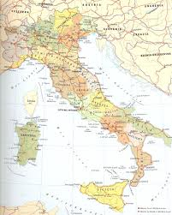
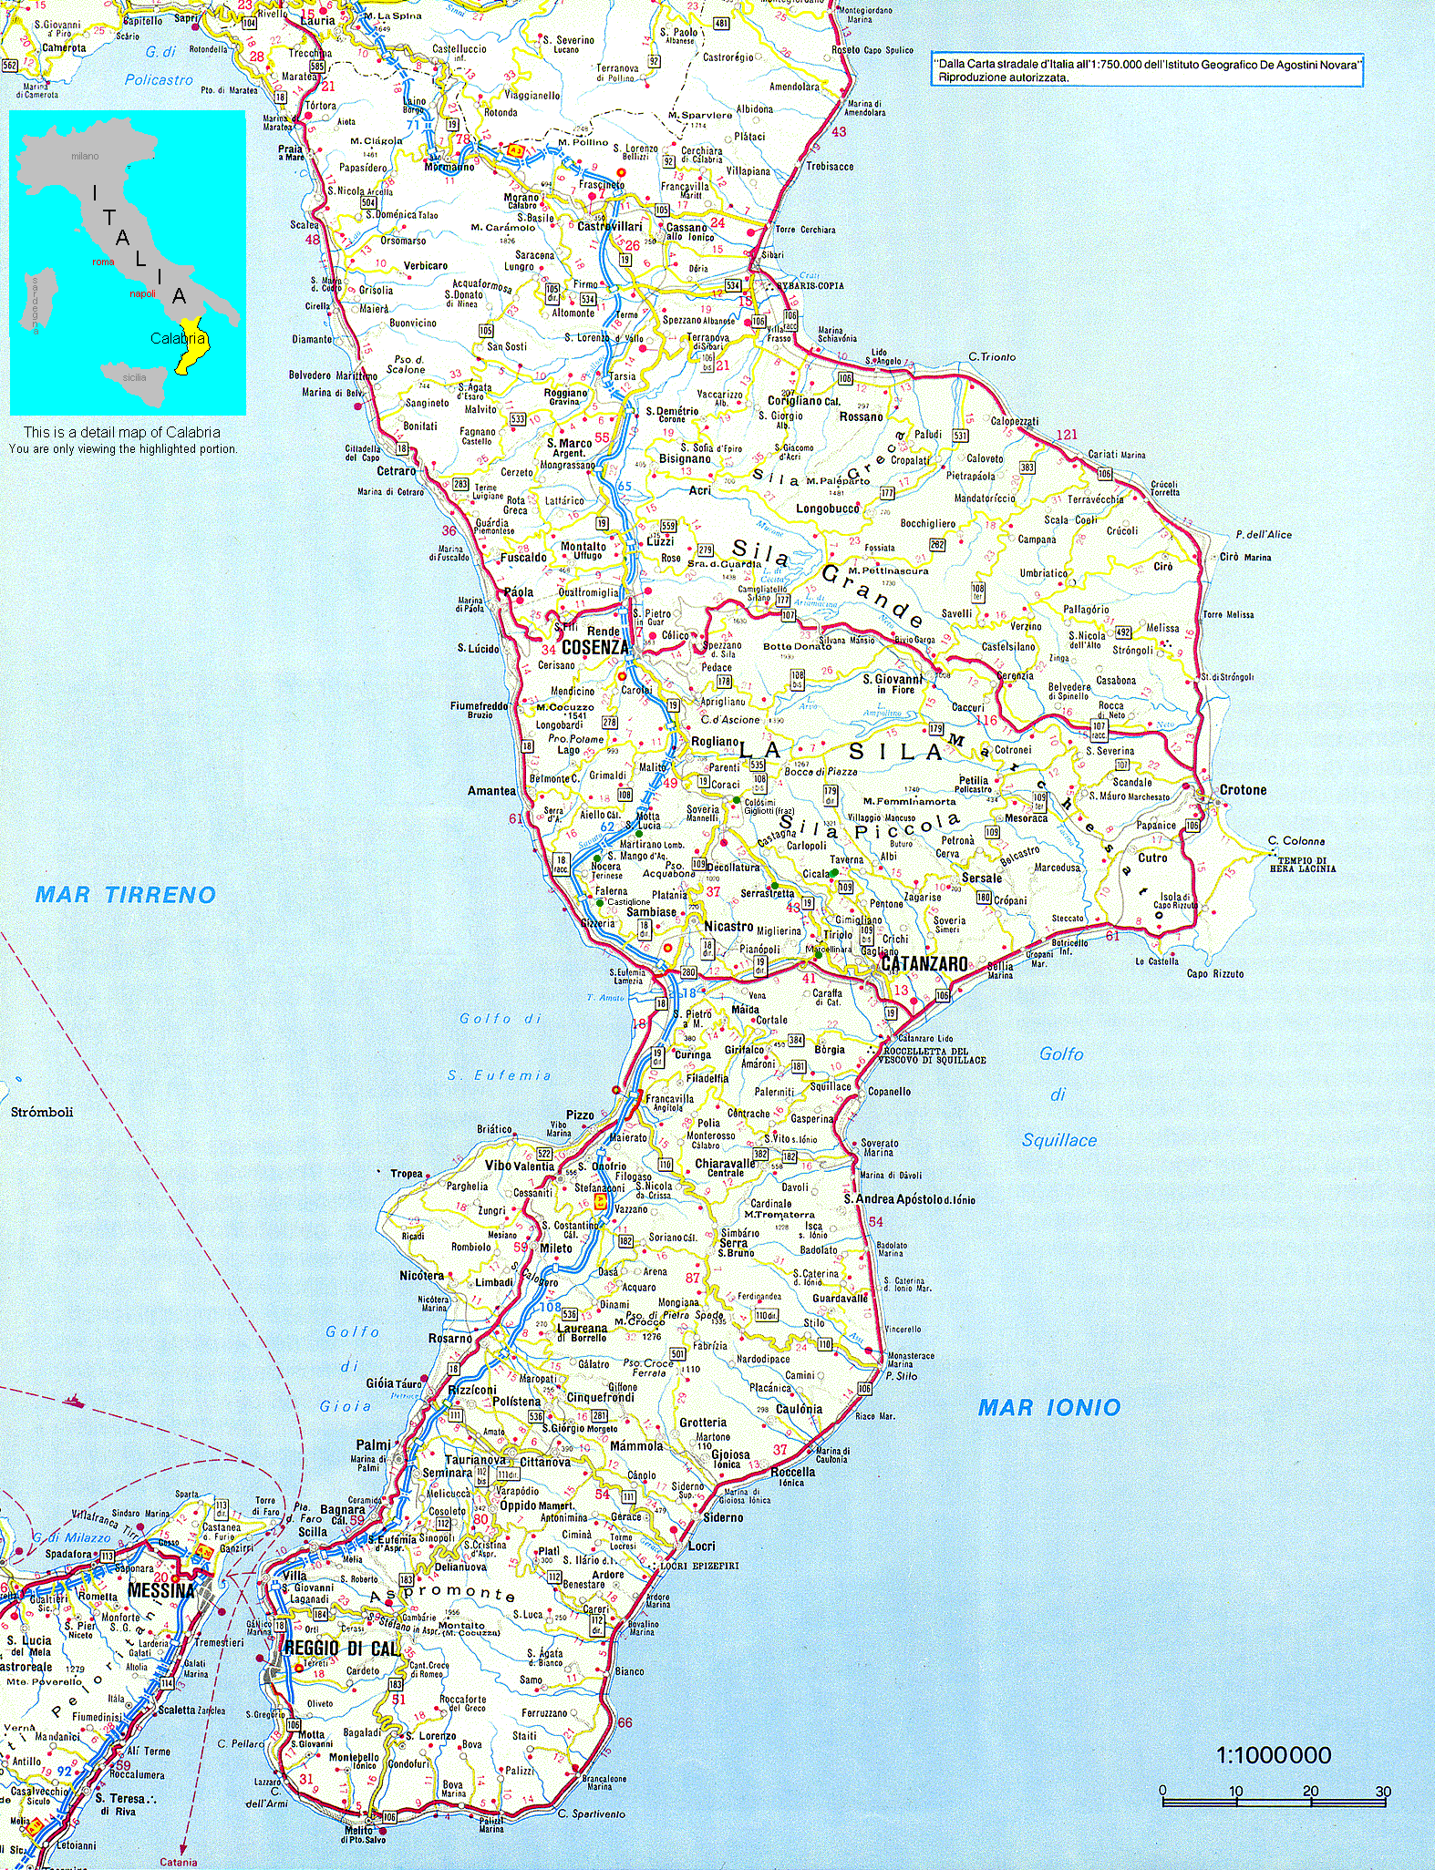
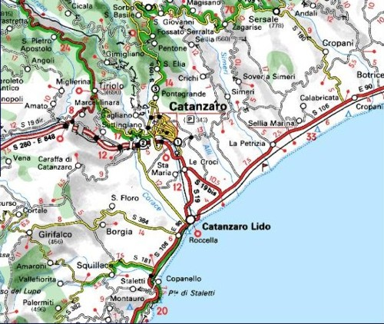
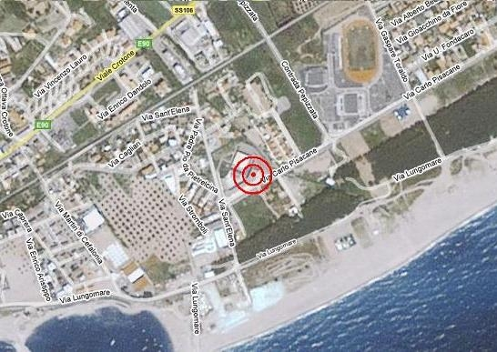

Slide 4
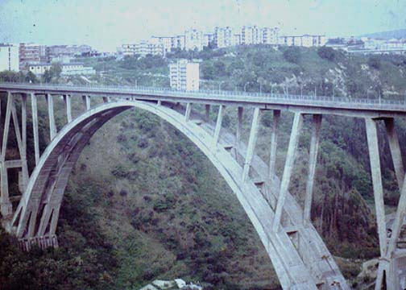
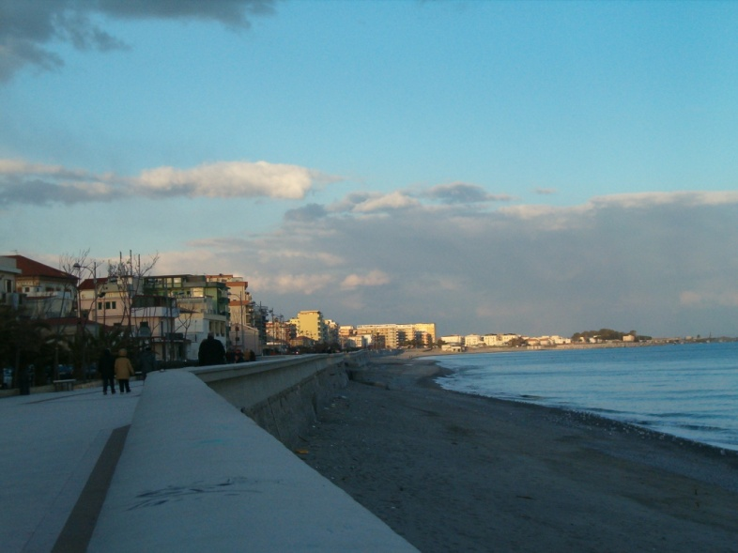
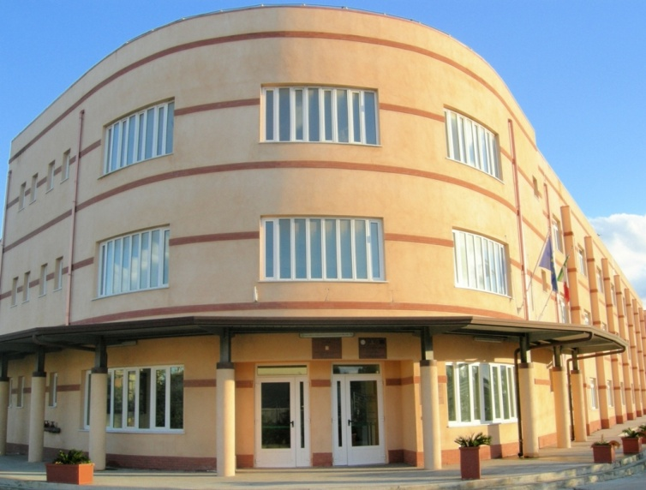
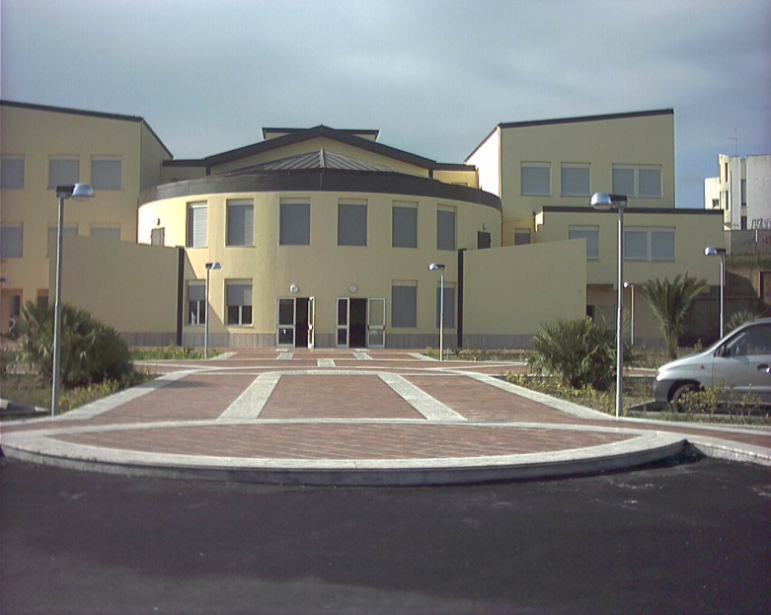
CITY OF CATANZARO
CATANZARO LIDO
The promenade
CATANZARO
The bridge “MORANDI”
ISTITUTO DI ISTRUZIONE SUPERIORE “E. FERMI”

Slide 5
ISTITUTO DI ISTRUZIONE SUPERIORE "E. FERMI"
LICEO SCIENTIFICO
Science Curriculum
LICEO LINGUISTICO
LICEO DELLE SCIENZE UMANE
Linguistic and Humanistic Curricula

Slide 6
DEVELOPMENT
Our school has five main programmes:
Foreign languages
Science
Human Science
Sport
Law and Economics
Our school:
Gives all students the opportunity to continue their studies at university.
Guarantees educational success and equal school opportunities through the integration and cooperation among different Institutions.
Offers curricular and extra-curricular projects (some of them financed by the EU)
Promotes work- related learning experiences with apprenticeship periods in companies, schools and universities.

Slide 7
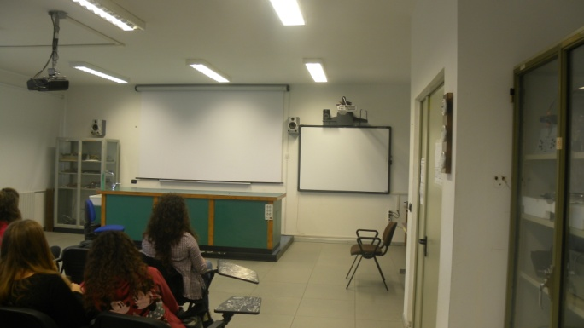
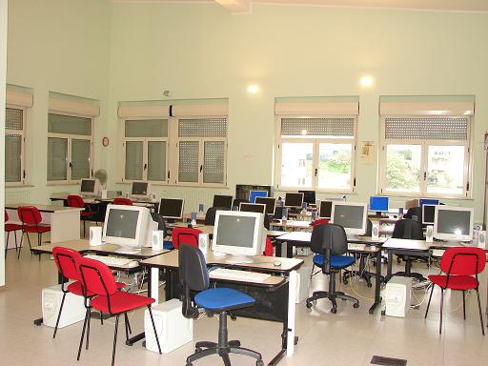
INNOVATION
The new national curricula of 2010 focus the main attention on the acquisition of Skills and Competences. As a consequence, a lot of teaching programmes have been remodelled according to this perspective.
Another novelty has been the introduction of new technology in teaching.
Although our school is well-equipped with laboratories, IWBs, teachers are not prepared and trained enough to use them in their daily practice.

Slide 8
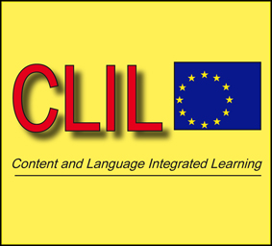
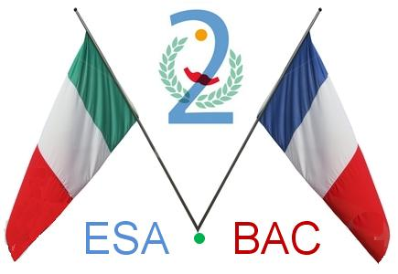
STUDENT IN THE CENTRE
or
TEACHER IN THE CENTRE?
Our lessons are tailored on students’ real needs, but we are aware that often we do not give them enough space to develop their skills and find solutions to tasks on their own. Our way of teaching sometimes makes students passive and not the active participants in the learning process.
The only few exceptions in which the students are really protagonists is during:
CLIL classes( teaching/learning subjects through a foreign language)
Foreign language classes
European projects
Esabac (an agreement sealed by the Italian and French Ministers of Education granting the achievement of a double high school diploma)

Slide 9
European and global dimension
We often consider our land as an outpost of Europe, that is the reason
why we have promoted and realized a series of initiatives to feel and make
our students feel European citizens:
1998/99 Socrates with the Berufsbildendeschule in Kaiserslautern (Germany)
2003/04 Comenius with Germany again.
2007/08 Comenius with Flemish Belgium.
5 private exchanges with the same German school.
Various exchanges with different European countries (The Netherlands, Spain,
France, some of them started from the E-twinning platform.)
Erasmus plus: in the course of this school year we have already received teachers from a Lithuanian school and teachers from a Swedish school for a job-shadowing experience.
PON and POR (special national projects ) . 2/3 weeks stays in the UK, France and Germany to strengthen language competences and skills according to CEFR.
Intercultura: In the past years a lot of students experienced a long stay in another country and we hosted students from every part of the world.

Slide 10
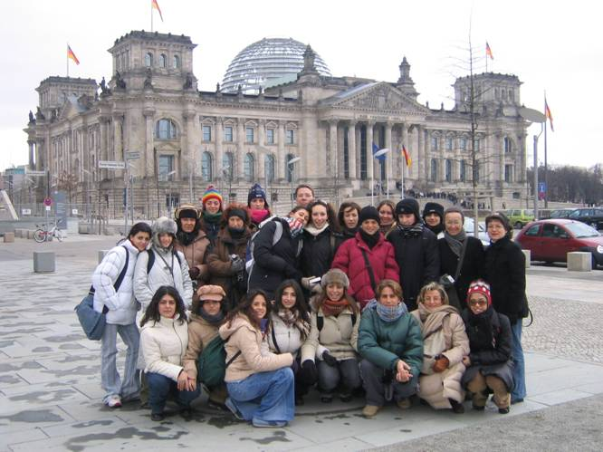
Comenius Project Germany 2004

Slide 11
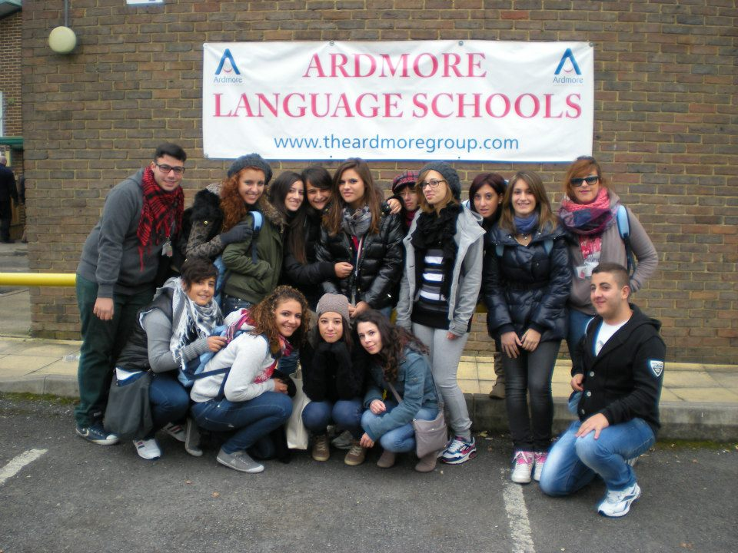
PON (National Offering Plan) Project - England October 2012

Slide 12
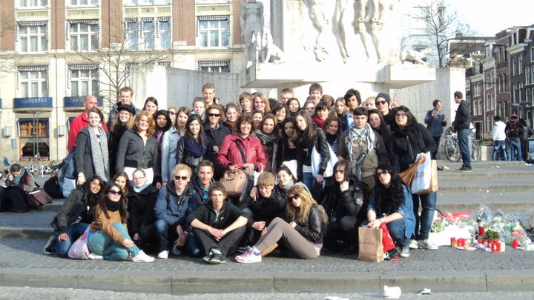
Cultural Exchange Italy-Holland 2010/11

